Slide 1


UX Design For The EYE Center Vision Screening App, QuickCheck
By Hyuk Gi Lee
Advisor William Erdly

Slide 2

What is QuickCheck?
Android based application with minimal cost associated with test equipment.
Quickly screen children for vision related problems such as near vision acuity, distance vision acuity with & without flippers, and stereopsis.
The app is implemented as an ambidextrous tool.
The EYE (Educating Young Eyes) Center
The EYE Center designs, develops, tests and distributes different technologies in order to raise awareness of the importance of functional vision in children for learning.
University of Washington Bothell non-profit organization.
Co-founders:
Professor Dr. William Erdly
Optometrist Dr. Alan Pearson

Slide 3
UX Design Process
Emphasize
Define
Ideate
Prototype
Test

Slide 4



Previous
Progression
Emphasize
Live Beta Version
Available Database
Value of Feedback

Slide 5
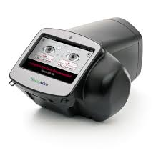
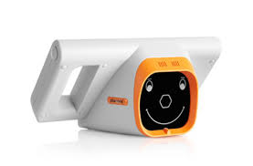
Screening Devices
Emphasize
Used by Washington State Schools
Cost: ~$7000
Duration of test:
Less than a minute
Test for:
Hyperopia, Myopia,
Astigmatism, Refraction,
Eye alignment, Anisocoria
Cost: ~$3000
Duration of test:
Less than a minute
Test for:
Refraction, Astigmatism, Hyperopia, Myopia, Eye alignment, anisocoria
Notes:
Reason why we have minimal cost

Slide 6


High Cost
Families feel pressured to have it at their home.

Slide 7
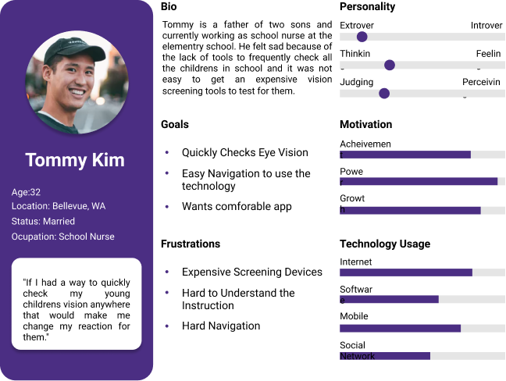
Persona
Emphasize
Needs better navigation
Needs better instruction
More visuals and better layouts.

Slide 8
Capstone Mission
Define
My mission is to create QuickCheck app recognizable to the customers, easily draw attention for the instructions and navigations, and bring customers to feel comfortable while they are using our app.
Notes:
Recognizable - having better visuals by revamping logo through color theory
Easily draw attention - instructions and navigation by improvement on the UI, subdominant, accents
Feel comfortable - simple design. Color blind - gray scale consistent design, intuitive design.

Slide 9
Make it
Draw Attention
Ideate
Revamping user flow and User Interfaces

Slide 10
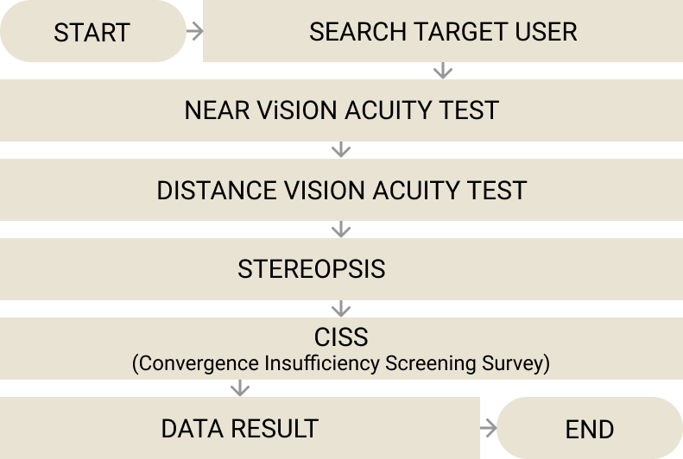

High Level Architecture Diagram

Slide 11
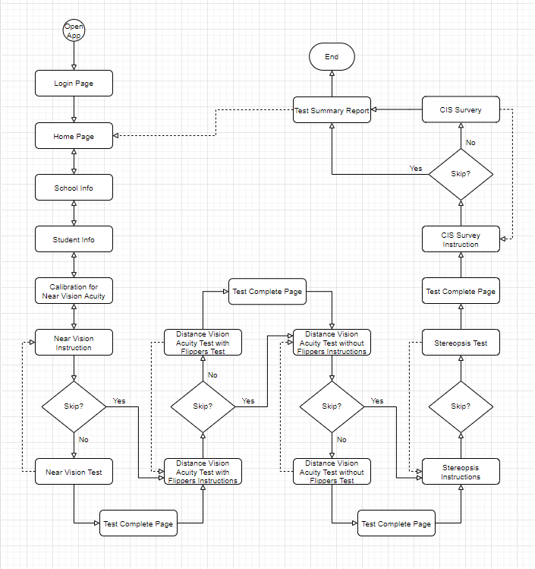
Ideate

Slide 12
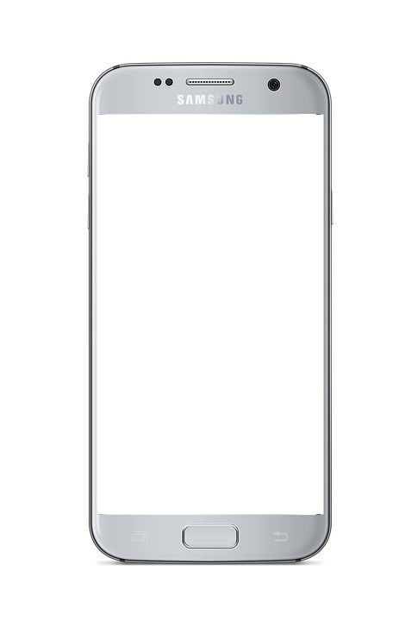
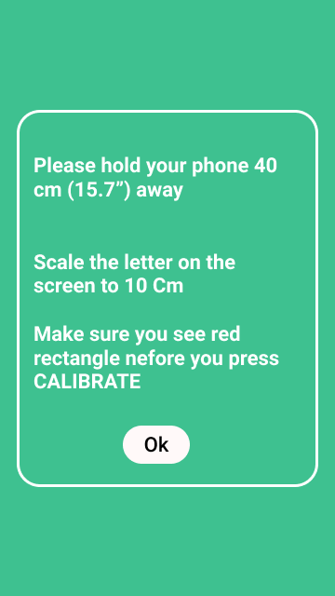
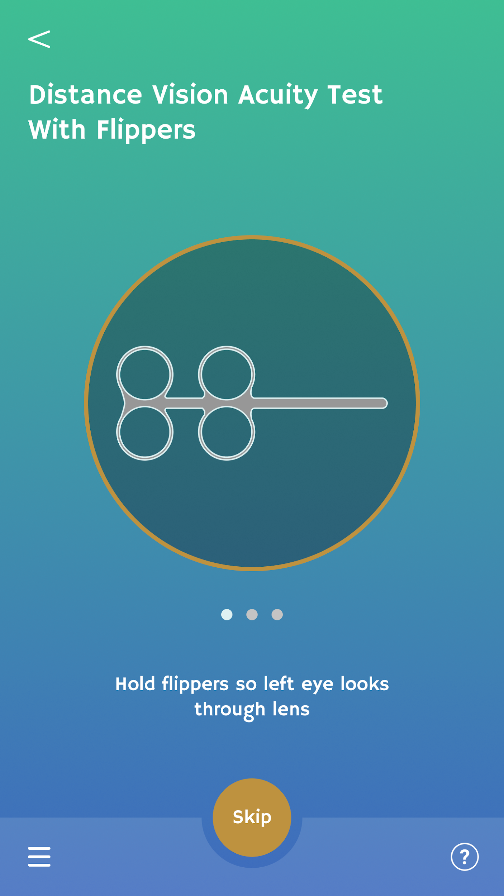
Attention
Circle
Ideate
Previous version
Updated version

Slide 13
Make it
Feel Comfortable
Prototype
Consistent Design, Grayscale

Slide 14
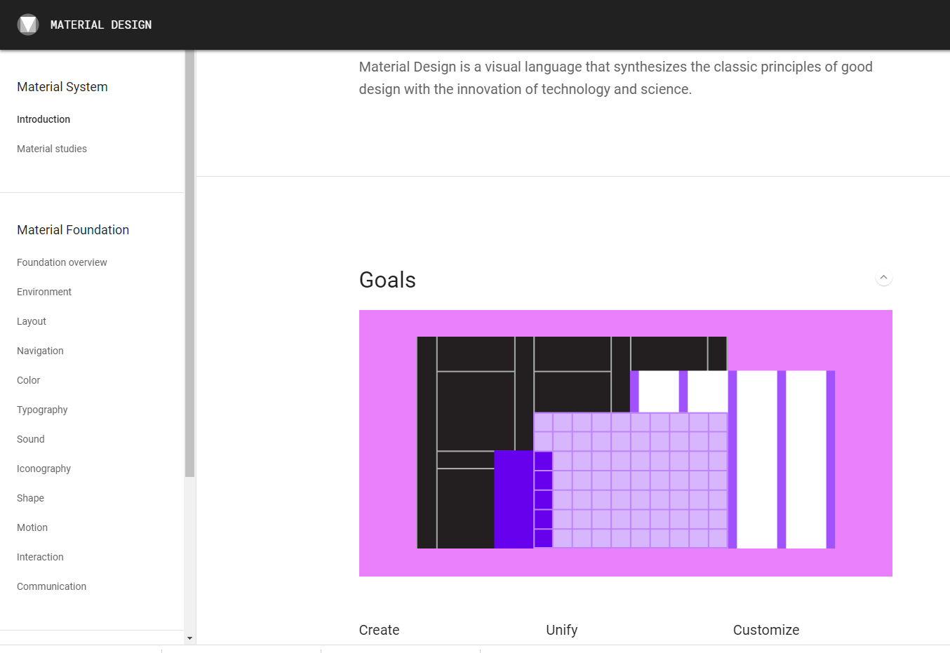
Prototype
Material Design:
a visual language that synthesizes the classic principles of good design with the innovation of technology and science.

Slide 15
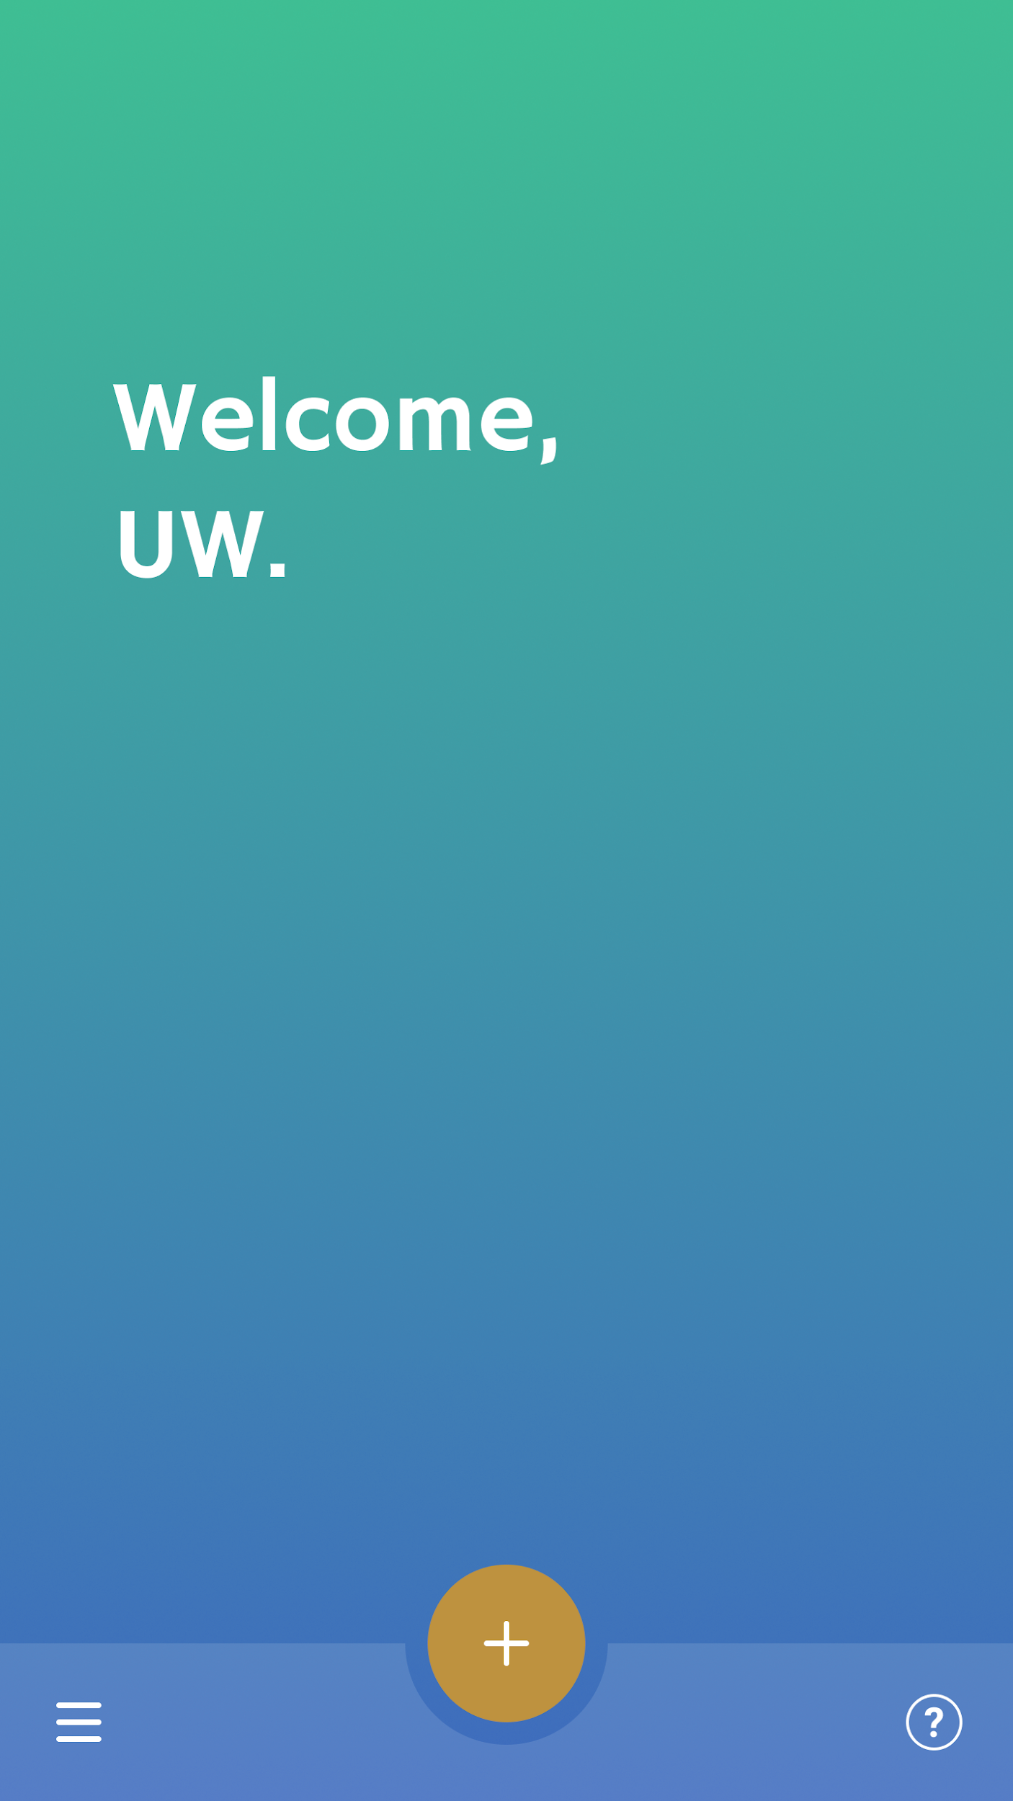
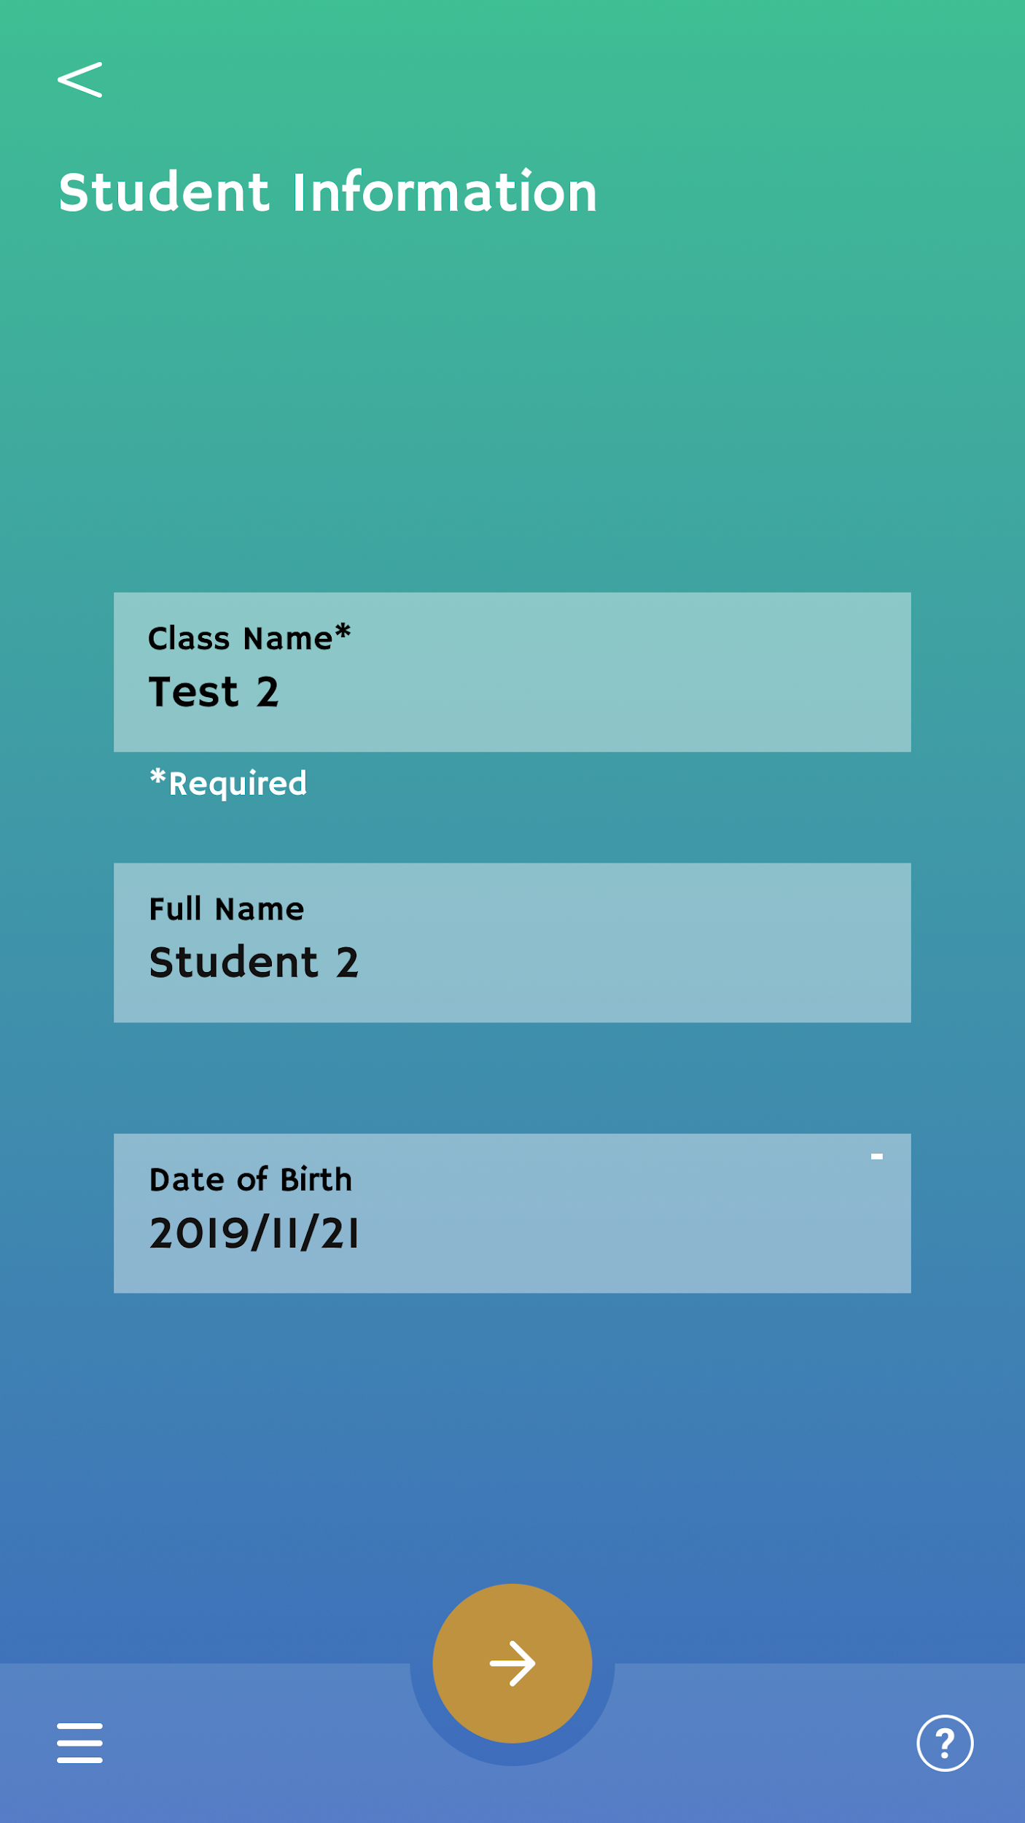
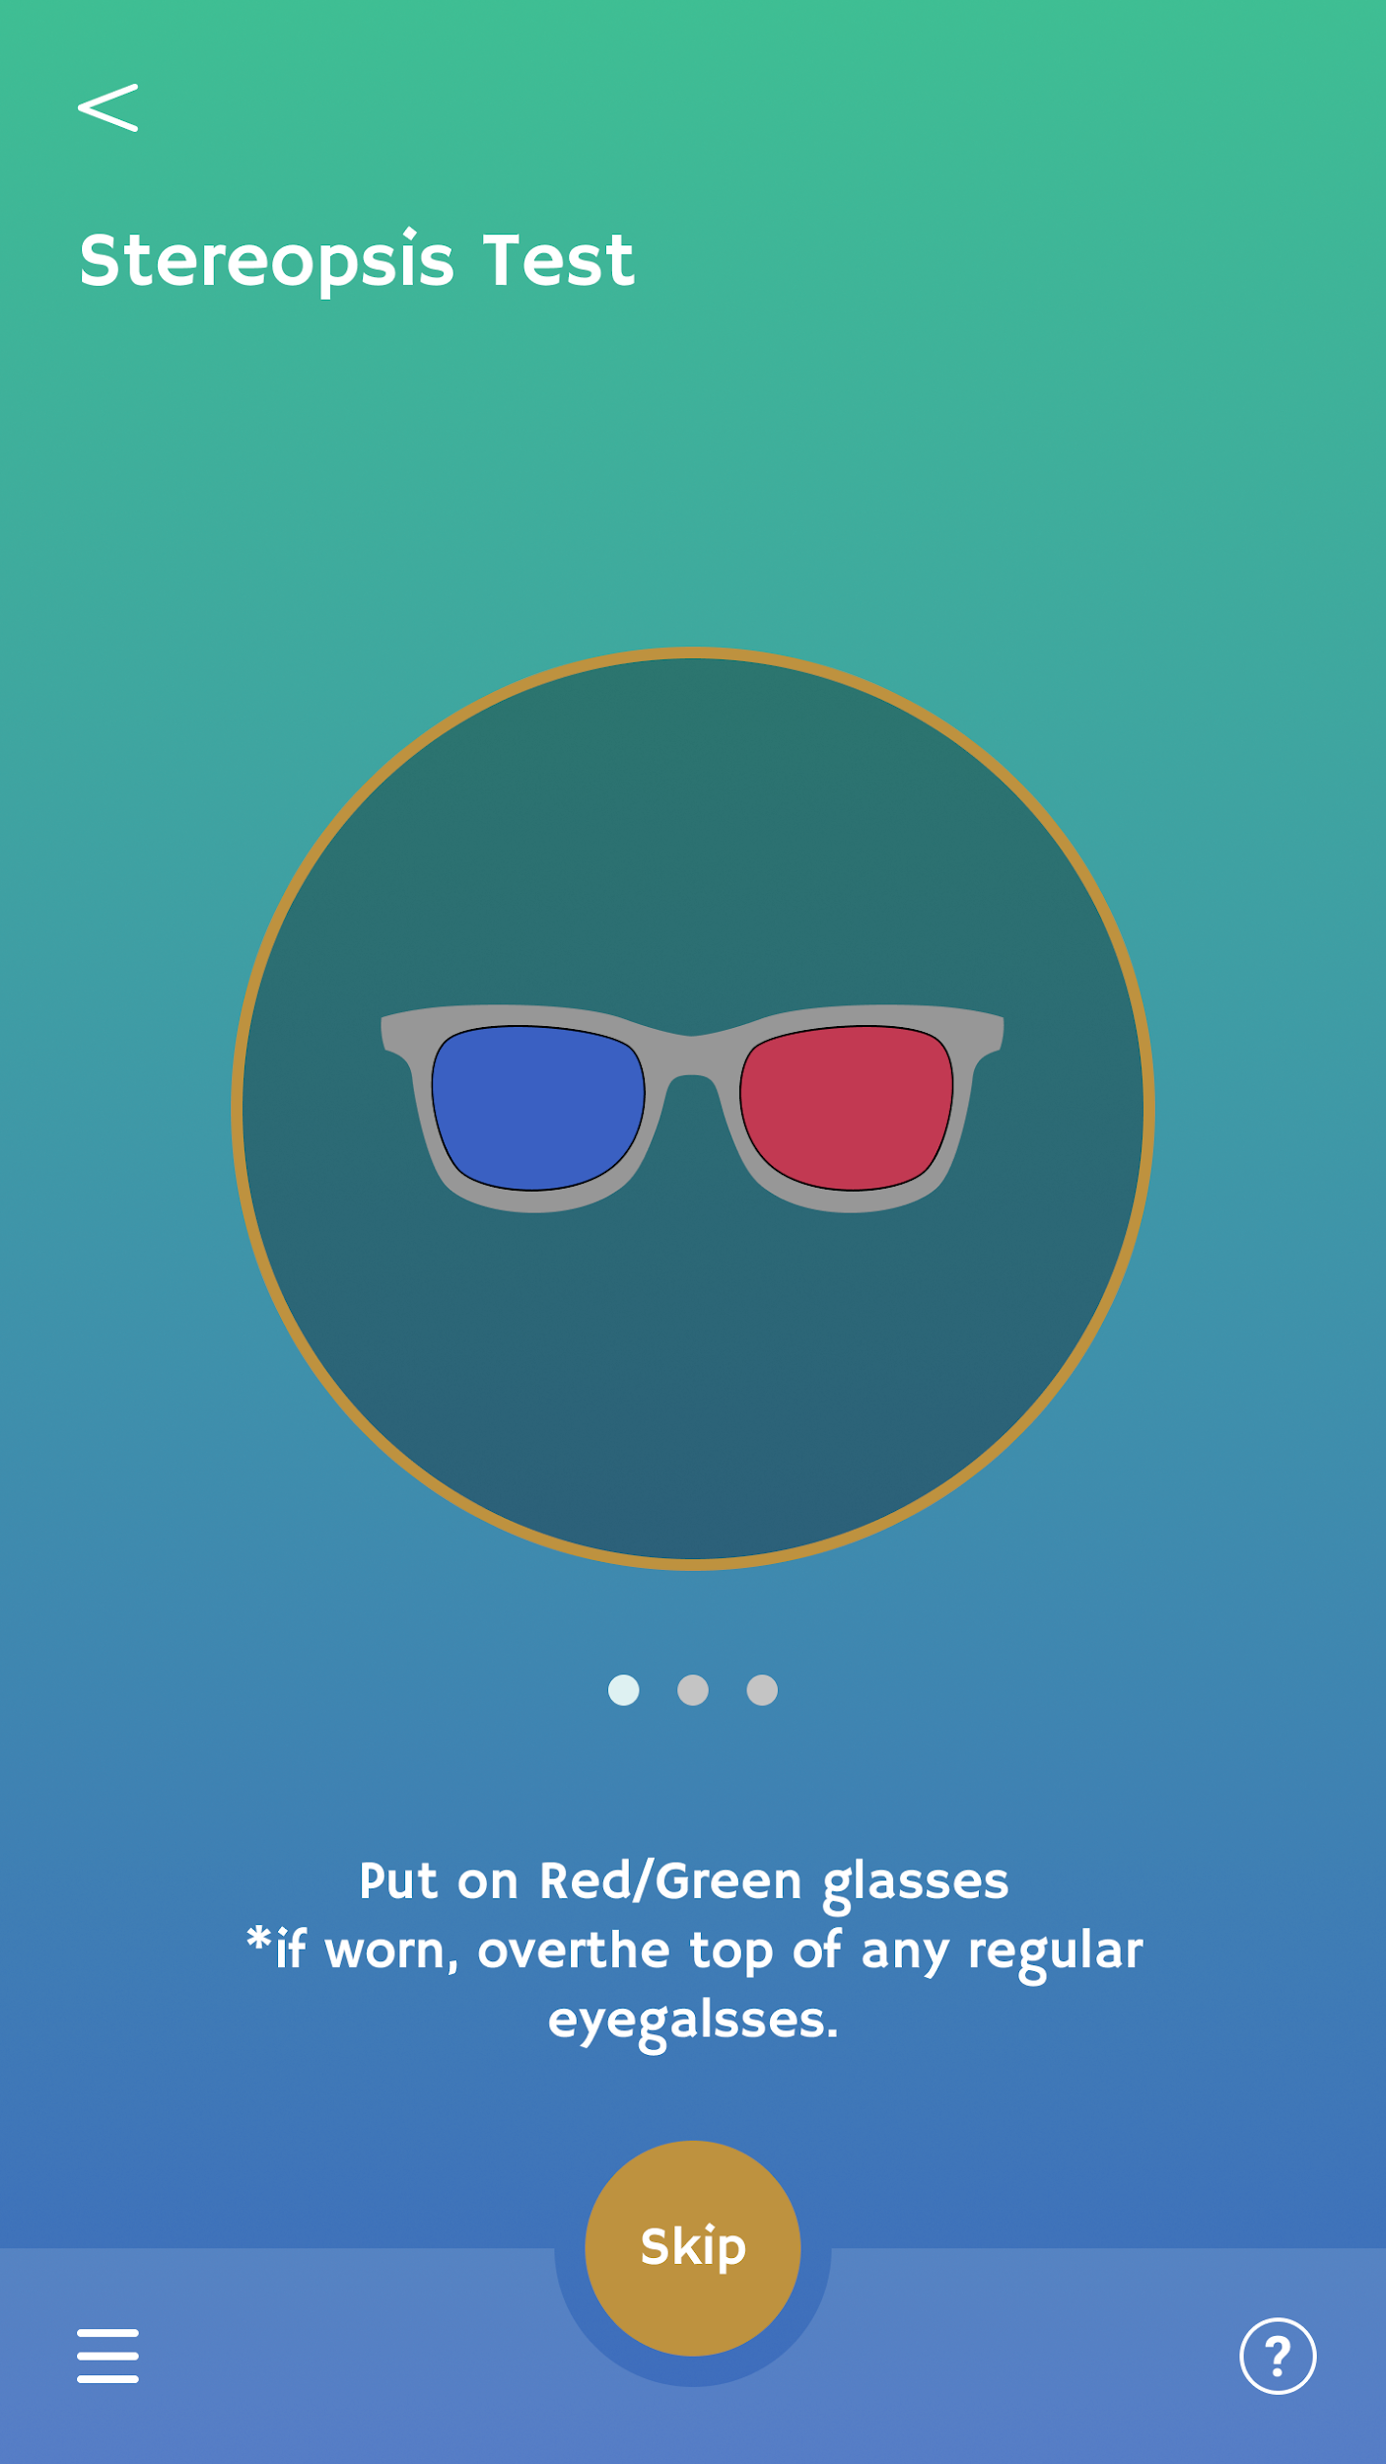

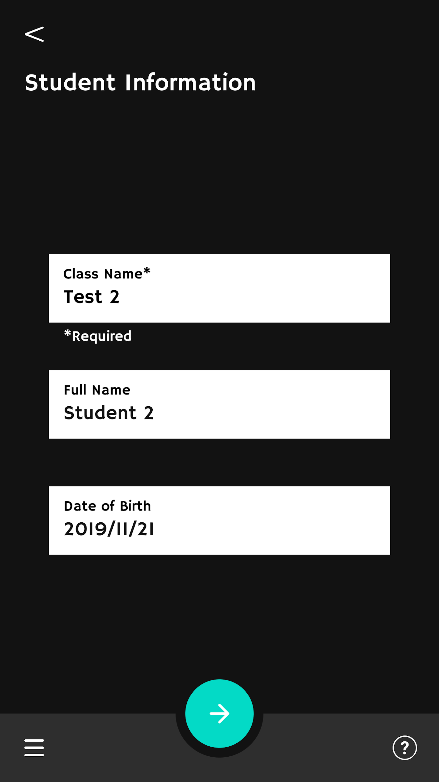
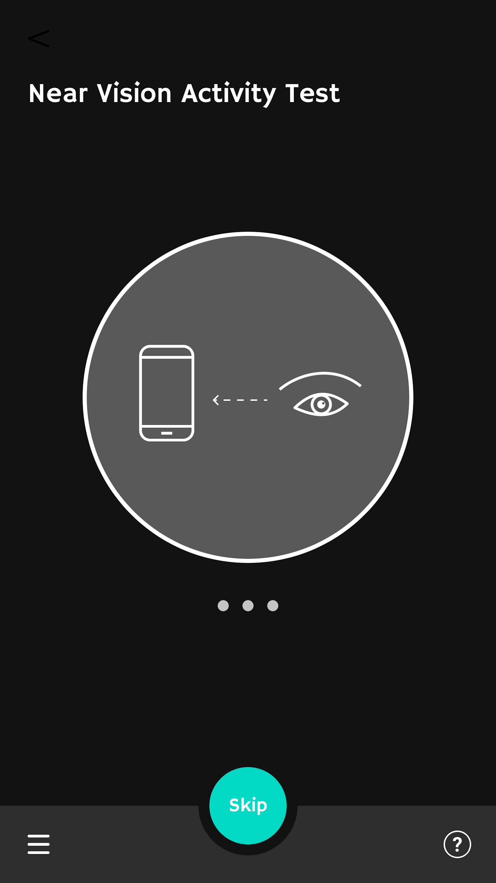
Consistent Design
Prototype
Light Version
Dark Version
Notes:
Gives Intuitive Design

Slide 16
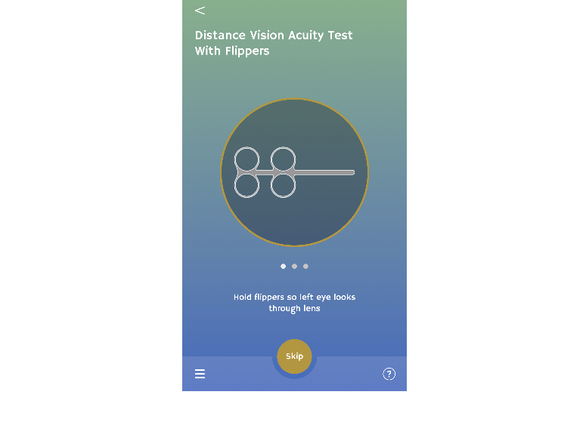
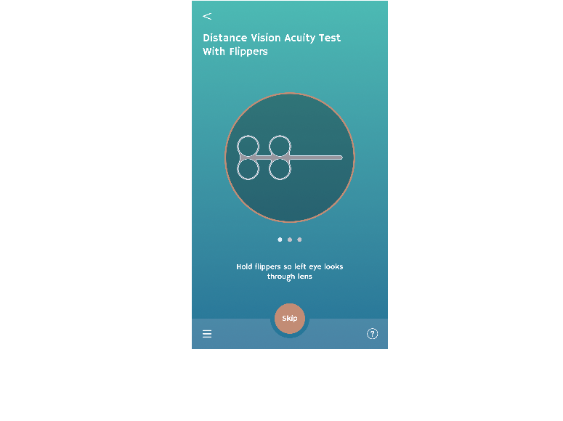
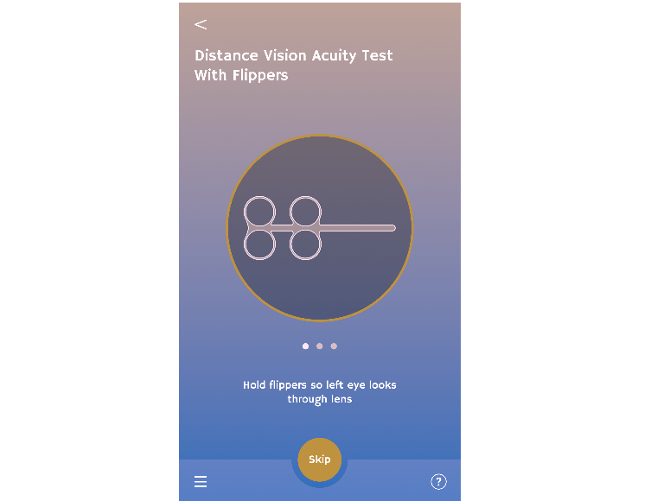
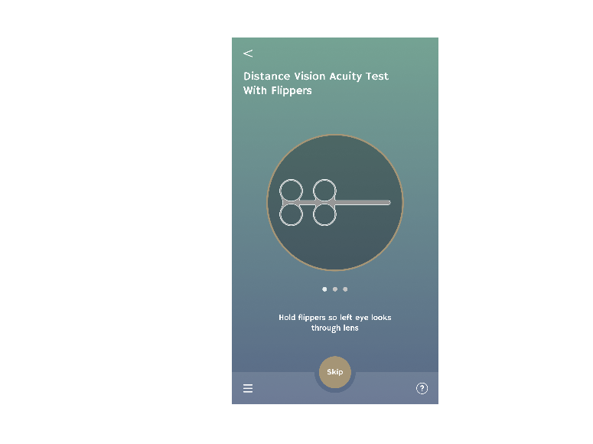
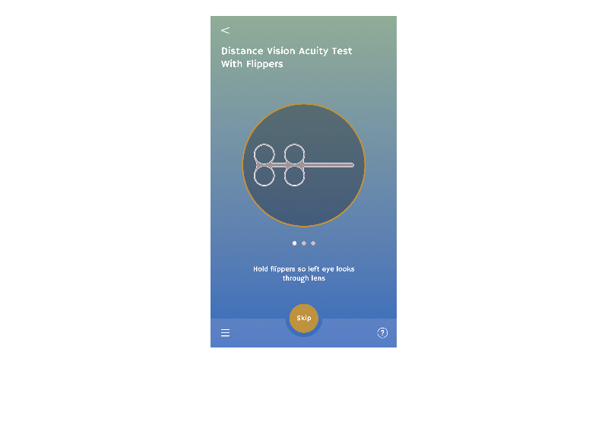
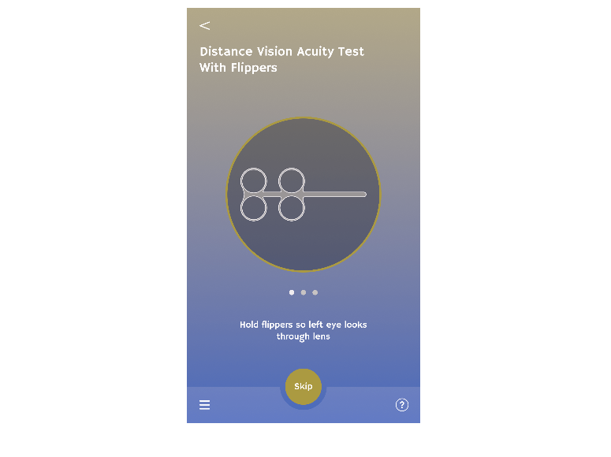
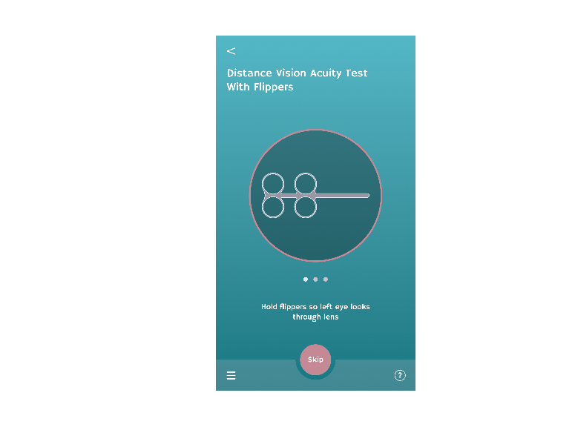
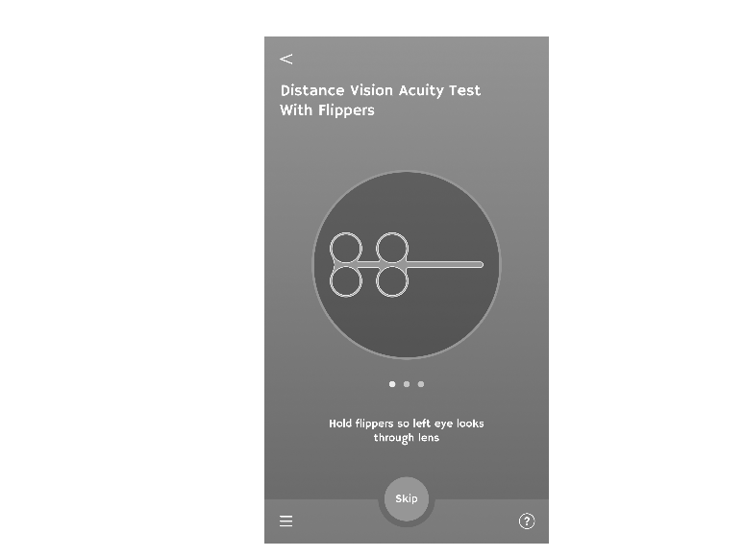
Grayscale for Color Blind
Prototype
Original
Anomalous
Trichromacy
Dichromatic
Monochromatic
Notes:
Gives Intuitive Design

Slide 17
Challenges:
What layout should we use for right and wrong function during the test?

Slide 18
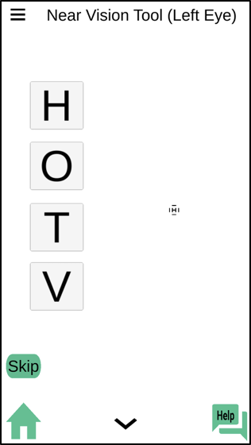
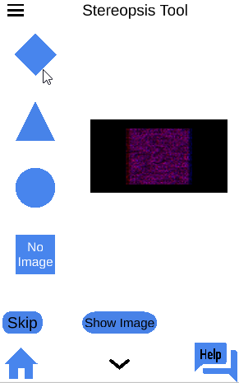
Prototype
Previous Version:
Flexible Ambidextrous
Distracted layout
Biased answer
Multiple option

Slide 19
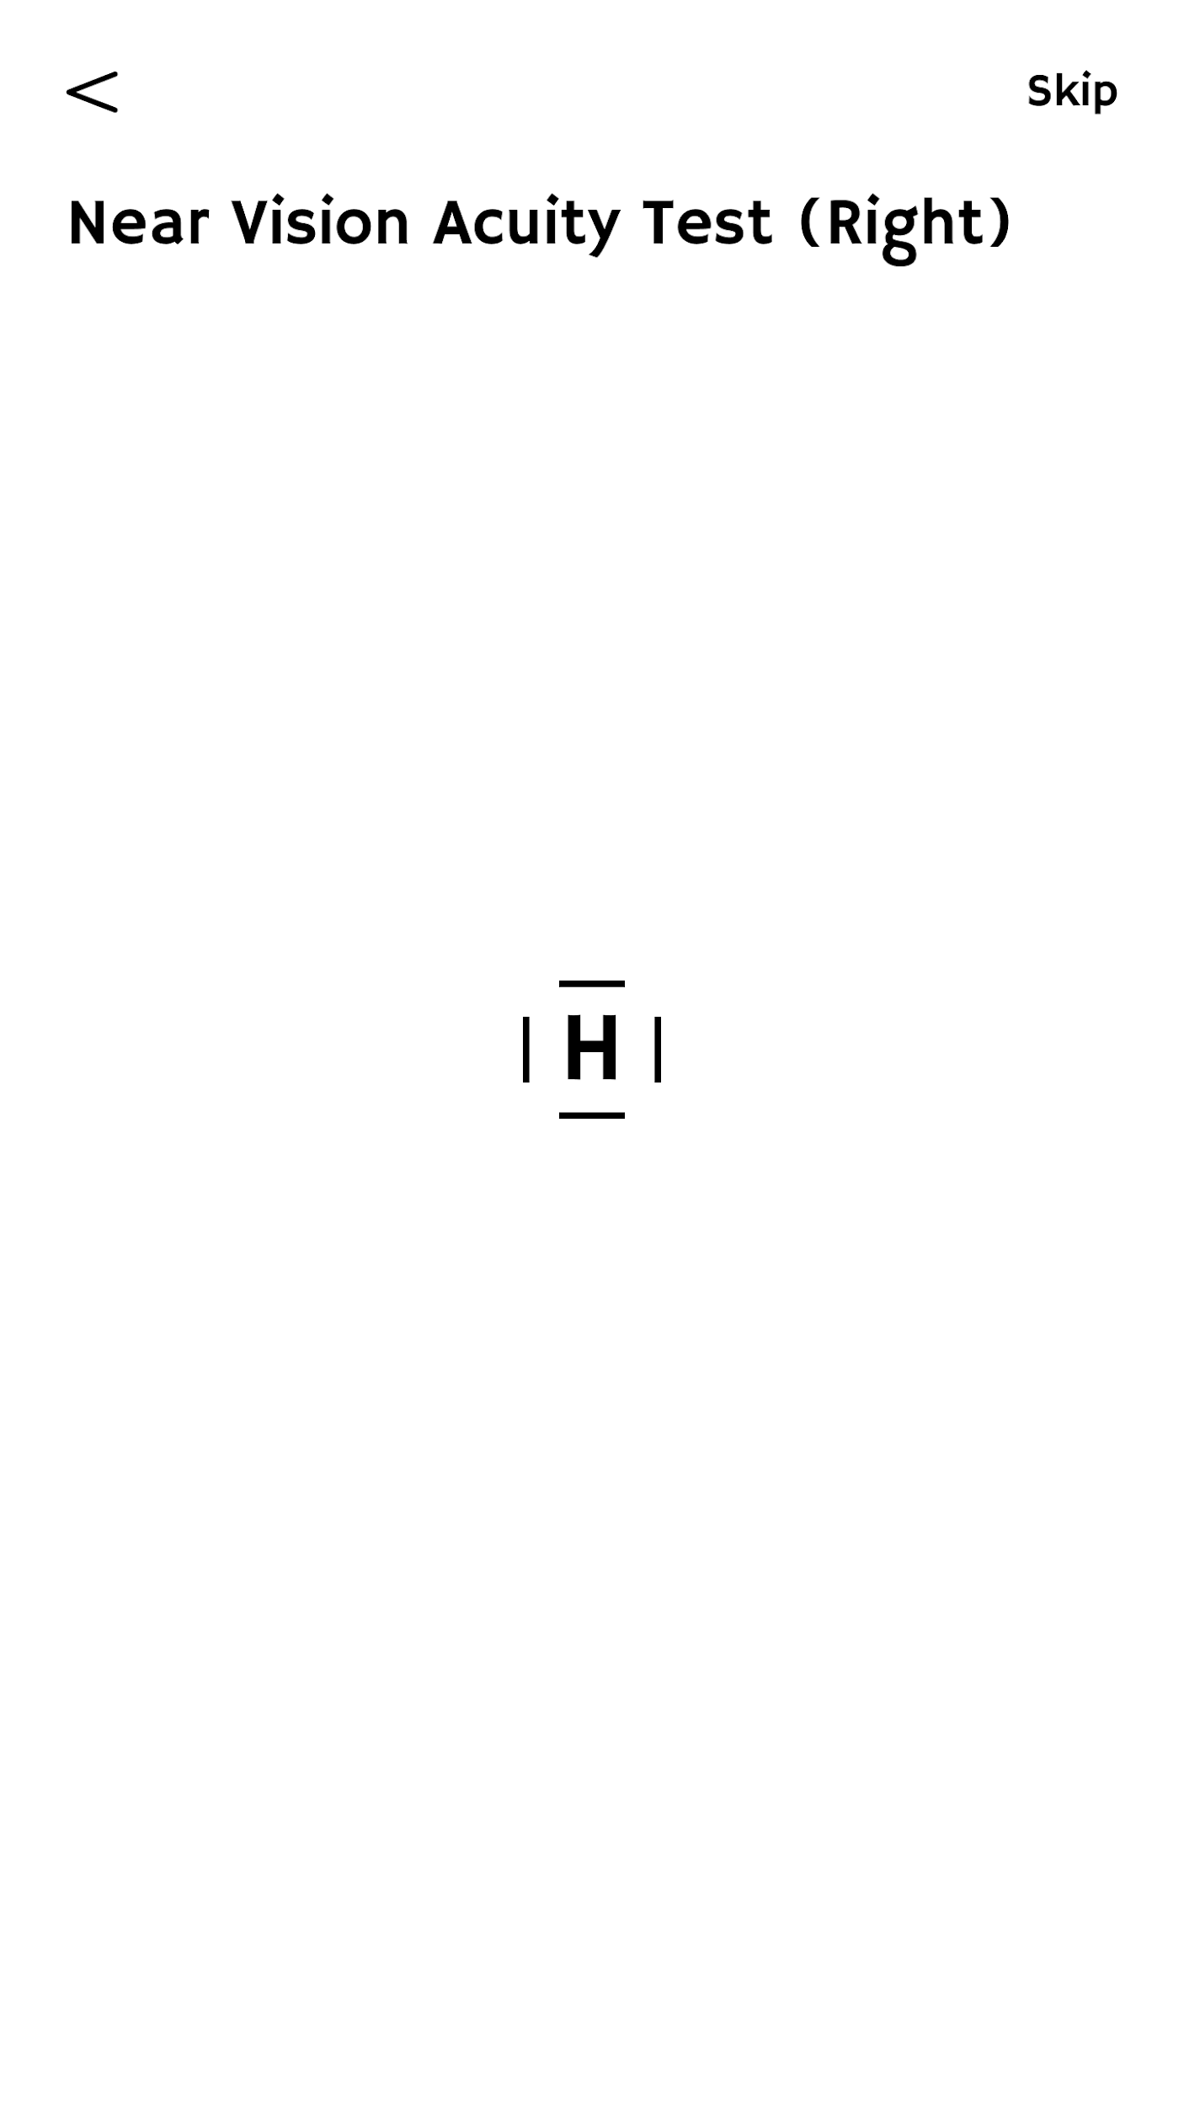


Multiple option
Using volume key
Tapping
The screen
Swiping the screen

Slide 20
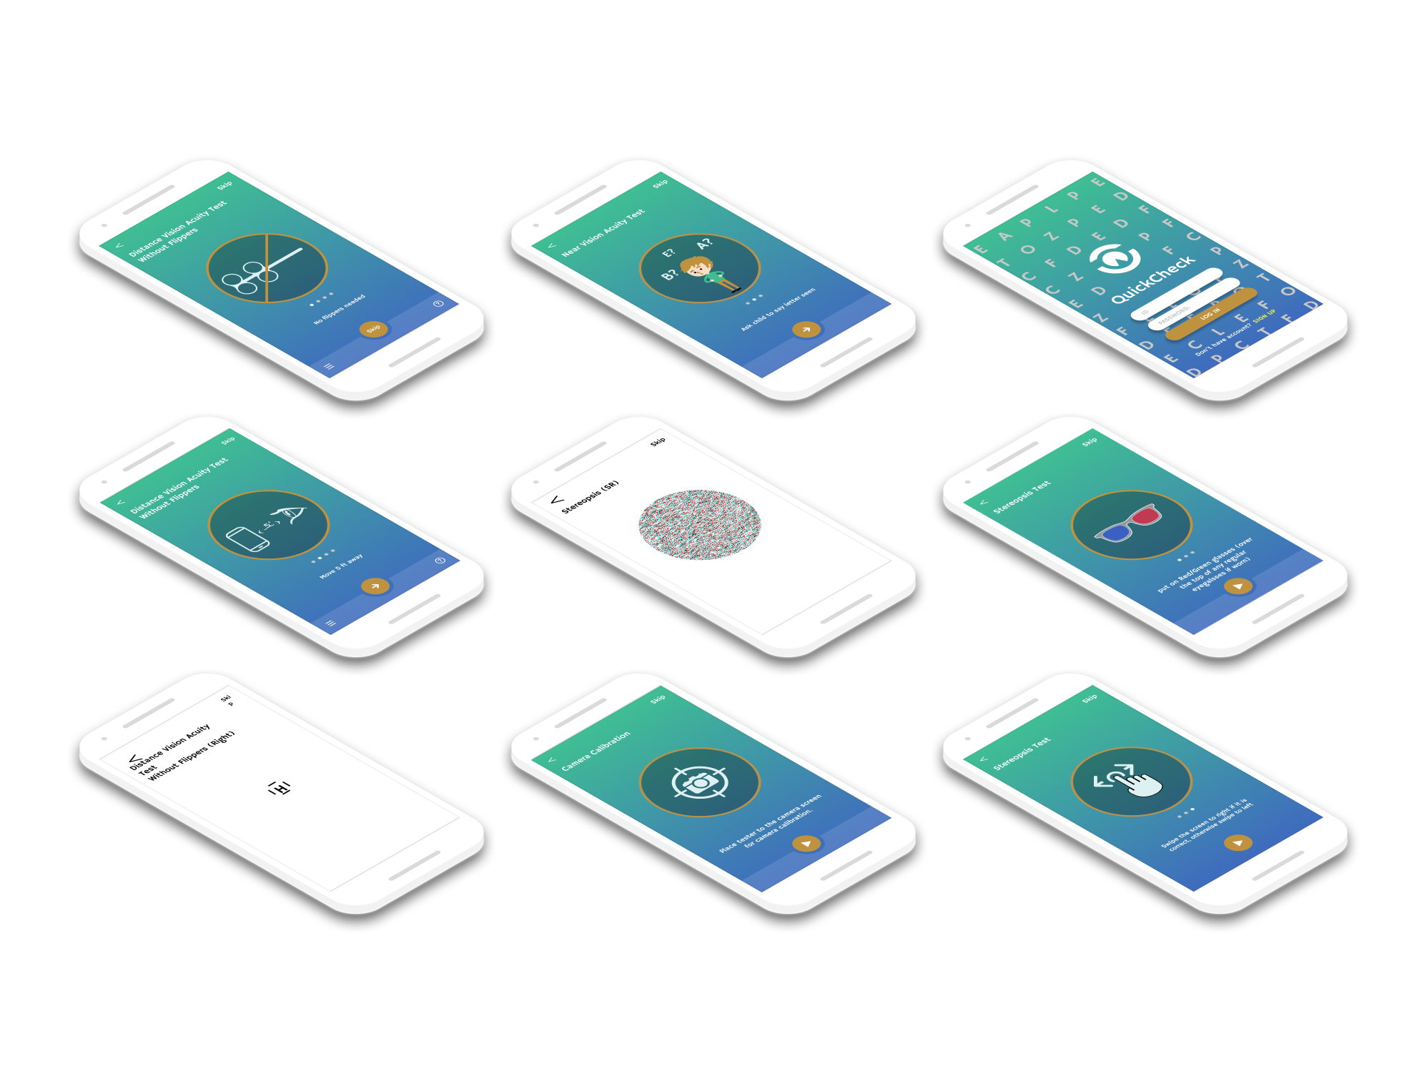
Prototype

Slide 21
Make it Recognizable
Prototype
Logo, color scheme, and fonts

Slide 22
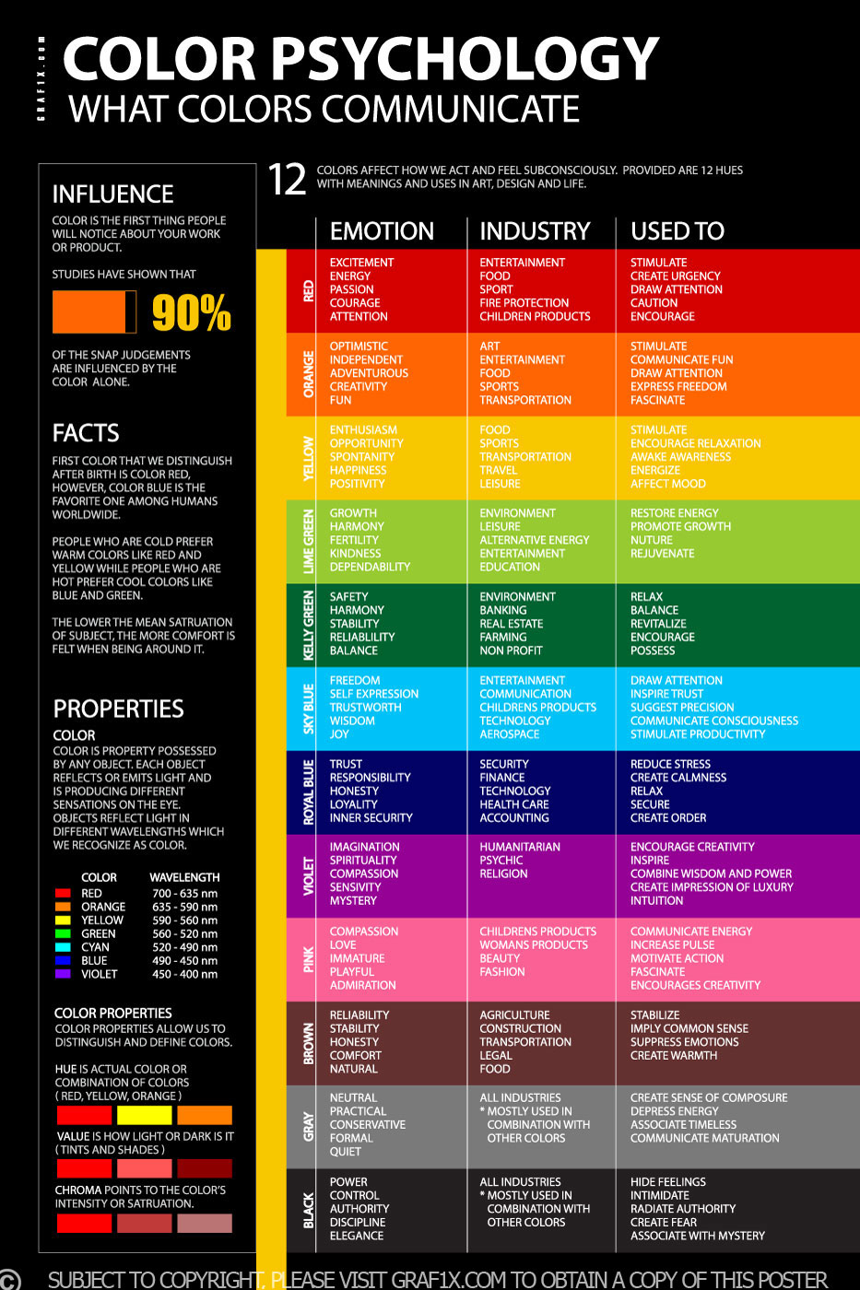
Finding Colors
Color emotion associated with:
Growth
Healthy
Balance
Comfort
Responsibility

Slide 23
Color Schemes
Hex #3FBE93
Hex #3F6BBE
Hex #BE923F
Hex #DEF1F2
Hex #FBFF32
Dominant
Subdominant
Accents
Notes:
Start with Green, used tetradic, analogous, and complementary colors.

Slide 24
Sans Serif Fonts
Prototype
Hammersmith One - 24pt
Hammersmith One - 14pt
Hammersmith One - 14pt
Hammersmith One - 12pt
Hammersmith One - 10pt
Low Contrast Typeface
Good for web type fonts
Easy to read
Works well on smaller sizes
Notes:
Start with Green, used tetradic, analogous, and complementary colors.

Slide 25

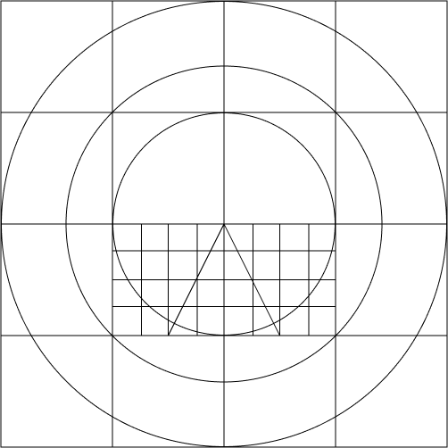


Logo
Prototype
Logo that is associated with:
Eye-health, Well-Being, Quickness + Balance and Clean

Slide 26
Prototype
Previous Version
https://drive.google.com/open?id=1LZMiwXUHf_XdKglv9soex5yMUI-o_duu
Updated Prototype
https://www.figma.com/proto/JYyUe6lKfuz63yPrsf5qGm/QuickCheck_HyukGiLee?node-id=657%3A1170&scaling=scale-down

Slide 27
Result
9 users
92%
Prototype
Test
Who participated in A/B testing
Total success!

Slide 28
Next Steps
A/B testing
More iterative process
Conduct more feedback

Slide 29
Helpful Courses
CSS 360, Software Engineering
CSS 370, Analysis and Design
CSS 480, Principles of Human-Computer Interaction

Slide 30
Thanks!
Any questions?
You can find me at
leeh54@uw.edu

Slide 31
